Slide 1

Lecture-3
Array Series
Core Topics:
Kadane’s Algorithm
Max Subarray Sum

Slide 2
Problem Statement
What is the Maximum Subarray Problem? Content:
Definition: Find the contiguous subarray with the largest sum.
Example:
Input: [-2, 1, -3, 4, -1, 2, 1, -5, 4]
Output: 6 (Subarray: [4, -1, 2, 1])
Applications:
Stock price analysis.
Signal processing.

Slide 3
Brute Force Approach
Brute Force Solution (Inefficient)
- Method: Check all possible subarrays.
- Time Complexity: O(n²) (Nested loops).
- Space Complexity: O(1).
Limitations: Fails for large arrays (e.g., n > 10,000).
Pseudocode:
int maxSum = Integer.MIN_VALUE;
for (int i = 0; i < nums.length; i++) {
int currentSum = 0;
for (int j = i; j < nums.length; j++) {
currentSum += nums[j];
maxSum = Math.max(maxSum, currentSum);
}
}
return maxSum;

Slide 4
Kadane’s Algorithm
Optimal Approach: Kadane’s Algorithm
Content:
- Key Idea:
- Track `maxEndingHere` (max subarray ending at current index).
- Track `maxSoFar` (global maximum).
- Rules:
1. `maxEndingHere = max(nums[i], maxEndingHere + nums[i])`.
2. `maxSoFar = max(maxSoFar, maxEndingHere)`.
- Visualization:
- Use an animation or table to show how values update.

Slide 5
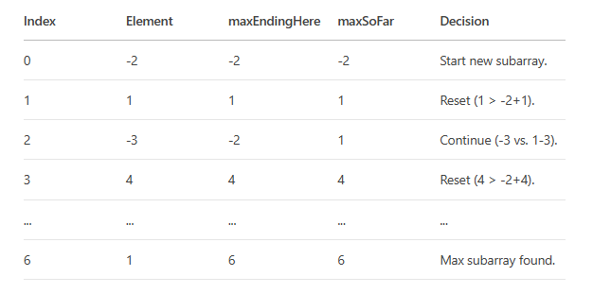
Step-by-Step Example
Walkthrough of Kadane’s Algorithm
Content:
- Input Array: `[-2, 1, -3, 4, -1, 2, 1, -5, 4]`
Step-by-Step Table:

Slide 6
Java Implementation
Kadane’s Algorithm in Java
Content:
- Code:
public int maxSubArray(int[] nums) {
int maxEndingHere = nums[0];
int maxSoFar = nums[0];
for (int i = 1; i < nums.length; i++) {
maxEndingHere = Math.max(nums[i], maxEndingHere + nums[i]);
maxSoFar = Math.max(maxSoFar, maxEndingHere);
}
return maxSoFar;
}
-Explanation:
- Initialize with the first element.
- Update `maxEndingHere` and `maxSoFar` in each iteration.

Slide 7
Edge Cases
Handling Edge Cases
Content:
1. All Negative Numbers:
- Input: `[-2, -3, -1, -5]` → Output: `-1` (subarray `[-1]`).
2. Circular Subarray:
- Use `totalSum - minSubarraySum` for wrap-around.
3. Empty Array:
- Return 0 or handle with a check.

Slide 8
Variations
Extensions of Kadane’s Algorithm
Content:
Maximum Product Subarray:
- Track `minEndingHere` and `maxEndingHere`.
Longest Subarray with Sum K:
- Hashmap-based solution.
Returning the Subarray Indices:
- Track `start` and `end` indices.

Slide 9
Practice Problems
Test Your Understanding
Content:
LeetCode 53: Maximum Subarray.
LeetCode 918: Maximum Sum Circular Subarray.
GeeksforGeeks: Print the Maximum Subarray.

